Slide 1

Class Relationships

Slide 2
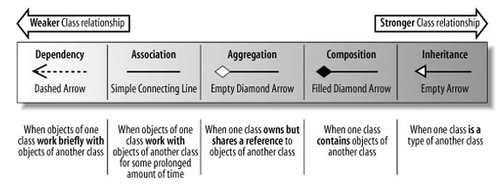
Class Relationships
The strength of a class relationship is based on how dependent the classes involved in the relationship are on each other. Two classes that are strongly dependent on one another are said to be tightly coupled.

Slide 3
Dependency
A dependency between two classes declares that a class needs to know about another class to use objects of that class.
The dependency relationship is often used when you have a class that is providing a set of general-purpose utility functions
This also implies that the classes can work without these utility functions but adding them will make life easier.

Slide 4
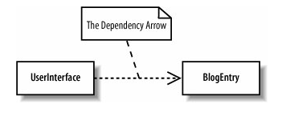
Dependency
The UserInterface is dependent on the BlogEntry class because it will need to read the contents of a blog's entries to display them to the user

Slide 5
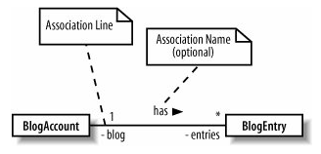
Association
Association means that a class will actually contain a reference to an object, or objects, of the other class in the form of an attribute
Navigability is often applied to an association relationship to describe which class contains the attribute that supports the relationship.

Slide 6
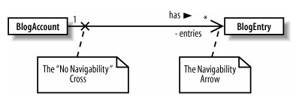
Association
In this diagram we show that the navigability is only in one direction. BlogAccount will have the entries attribute of type BlogEntry

Slide 7
Association Classes
Sometimes an association itself introduces new classes. Association classes are particularly useful in complex cases when you want to show that a class is related to two classes because those two classes have a relationship with each other.

Slide 8
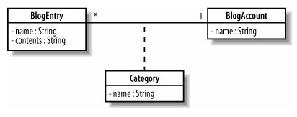
Association Classes
Example:
BlogEntry class is associated with a BlogAccount. However, depending on the categories that the account contains, the blog entry is also associated with any number of categories.

Slide 9
public class BlogAccount {
private String name;
private Category[] categories;
private BlogEntry[] entries;
}
public class Category {
private String name;
}
public class BlogEntry {
private String name;
private Category[] categories
}

Slide 10
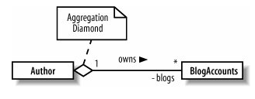
Aggregation
Aggregation is really just a stronger version of association and is used to indicate that a class actually owns but may share objects of another class.
Aggregation is shown by using an empty diamond arrowhead next to the owning class
In an aggregation relationship, the part may be independent of the whole but the whole requires the part.

Slide 11
Code Example
class Window
{
private:
vector<Shape*> itsShapes;
};
A window may contain many shapes but having a shape is not necessary for having a window.

Slide 12
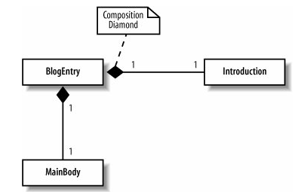
Composition
Composition is an even stronger relationship than aggregation, although they work in very similar ways. Composition is shown using a closed, or filled, diamond arrowhead.
The instance of the aggregated class is destroyed with the aggregating class

Slide 13
Code Example
class Circle
{
public:
void SetCenter(const Point&);
void SetRadius(double);
double Area() const;
double Circumference() const;
private:
double itsRadius;
Point itsCenter;
};

Slide 14
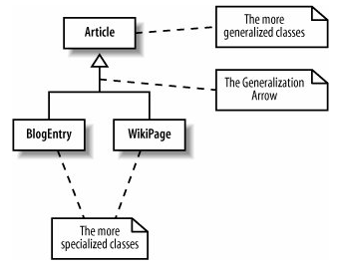
Generalization (Inheritance)
Generalization and inheritance are used to describe a class that is a type of another class
Parent classes describe a more general type, which is then made more specialized in child classes .

Slide 15
Generalization and implementation reuse
A child class inherits and reuses all of the attributes and methods that the parent contains and that have public, protected, or default visibility.
One of the principles of good object-oriented design is to avoid tightly coupling classes so that when one class changes, you don't end up having to change a bunch of other classes as well.

Slide 16
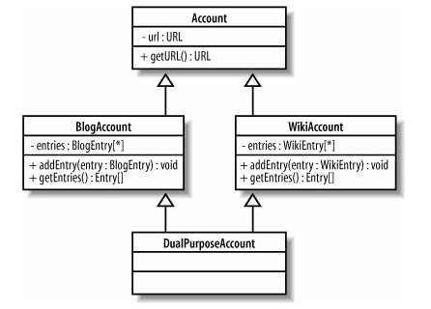
Multiple Inheritance
Multiple inheritance or multiple generalization in the official UML terminology occurs when a class inherits from two or more parent classes.
It is supported in C++, but is not supported in Java. How then will you do multiple inheritance in Java?

Slide 17
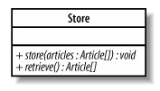
Abstract Class
A class in which you are unable to define all the behaviors is called an abstract class
Normally, in such a scenario, the specialized child classes are used to define those behaviors
An abstract class cannot have an instance
The behaviors that are overwritten in the child classes are written in italics in the parent class

Slide 18
About Interfaces
An interface is a collection of operations that have no corresponding method implementations.
Very similar to an abstract class that contains only abstract methods.
A very simple contract that declares:
"These are the operations that must be implemented by classes that intend to meet this contract."

Slide 19
Implementation in Languages
In C++ interfaces are implemented as abstract classes that contain no operation implementations. In newer languages, such as Java and C#, an interface has its own special construct.
Sometimes an interface will contain attributes as well, but in those cases, the attributes are usually static and are often constants.
An interface cannot have an instance

Slide 20
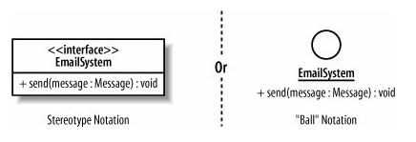
Notation
In UML, an interface can be shown as a stereotyped class notation or by using its own ball notation.

Slide 21
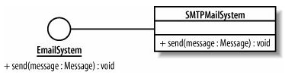
Notation
If you are using the "ball" interface notation, then you realize an interface by associating it with a class

Slide 22

Notation
If you have used the stereotype notation for your interface, then a new arrow is needed to show that this is a realization relationship.
Realization is sort of like Inheritance and means that the implementation has been realized in a class.

Slide 23

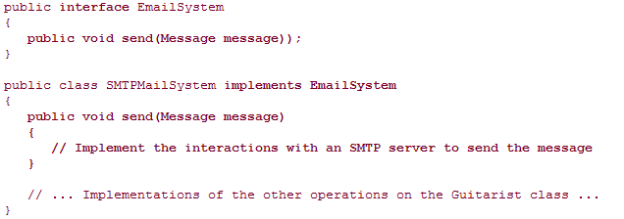
Java Example

Slide 24
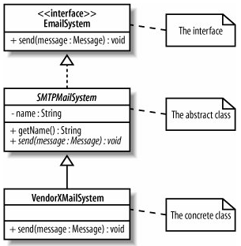
Interface & Abstract Classes
If a class realizes an interface but does not implement all of the operations that the interface specifies, then that class needs to be declared abstract

Slide 25
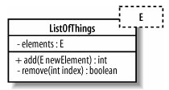
Templates
A template or parameterized class, as they are sometimes referred to is helpful when you want to postpone the decision as to which classes a class will work with.
A template in UML is shown by providing an extra box with a dashed border to the top right of the regular class box.

Slide 26
Object Diagrams
Compared to class diagrams, object diagram notation is very simple.
Despite having a fairly limited vocabulary, object diagrams are particularly useful when you want to describe how the objects within the system would work together in a particular scenario.
They also draw attention to the many ways that the objects will exist and interact within your system at runtime.

Slide 27



Object Instances
You show an instantiated object by using a rectangle but with the name of the object identifier underlined.
You can also add the class name to the object name.
one final type of object that you might want to use on your object diagrams, the anonymous object.

Slide 28
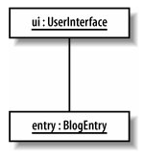
Links
To show how objects will work together in a particular runtime configuration, you need to tie those objects together using links.
Links between objects on an object diagram show that the two objects can communicate with each other. If you create a link between two objects, there must be a corresponding association between the classes.

Slide 29
The End

